Slide 1
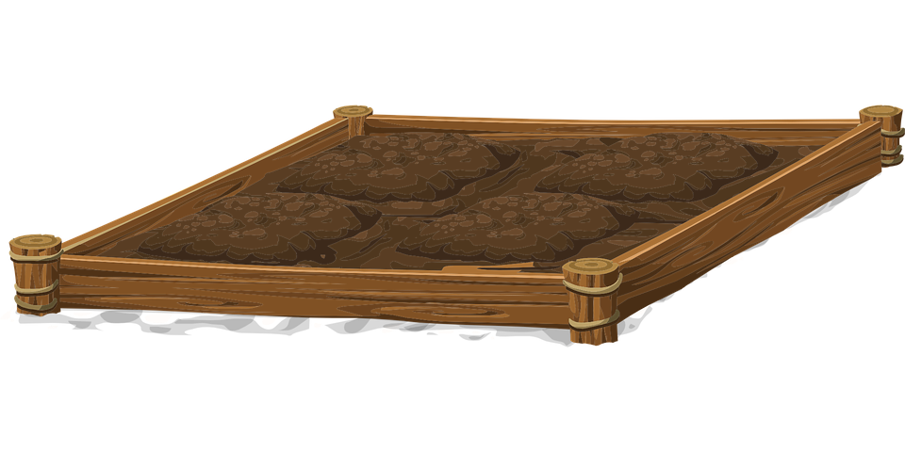
IoT Herb Garden
Parker Killian
Justin Wald
Michael Barger
IOT Course Project - Team 11

Slide 2
Project Goals
Automate watering of plants
Log the environment attributes and soil watering
Use these logs to display graphs in a web server
Allow the web server to edit configuration of plants, send manual pumps

Slide 3
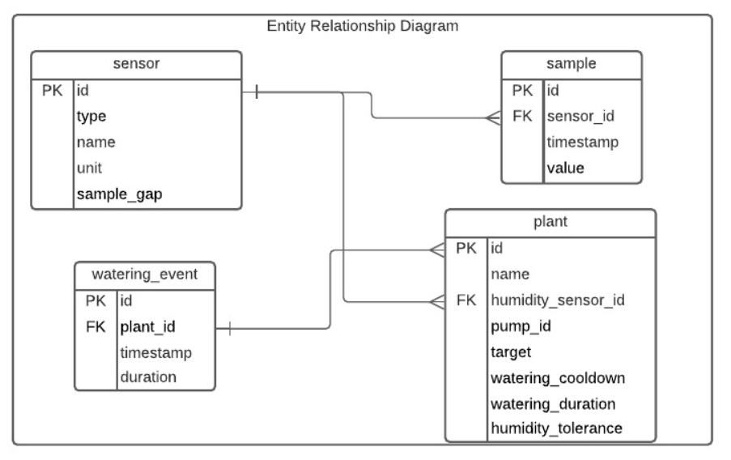
Database Structure
Sensor
Stores information of each sensor in the system
Plant
Stores information about each plant in the system
Connects plants to their sensor and pump
Controls when to water the plant
Sample
Stores data from individual samples from the sensors
Watering_event
Stores a record of pump operations

Slide 4
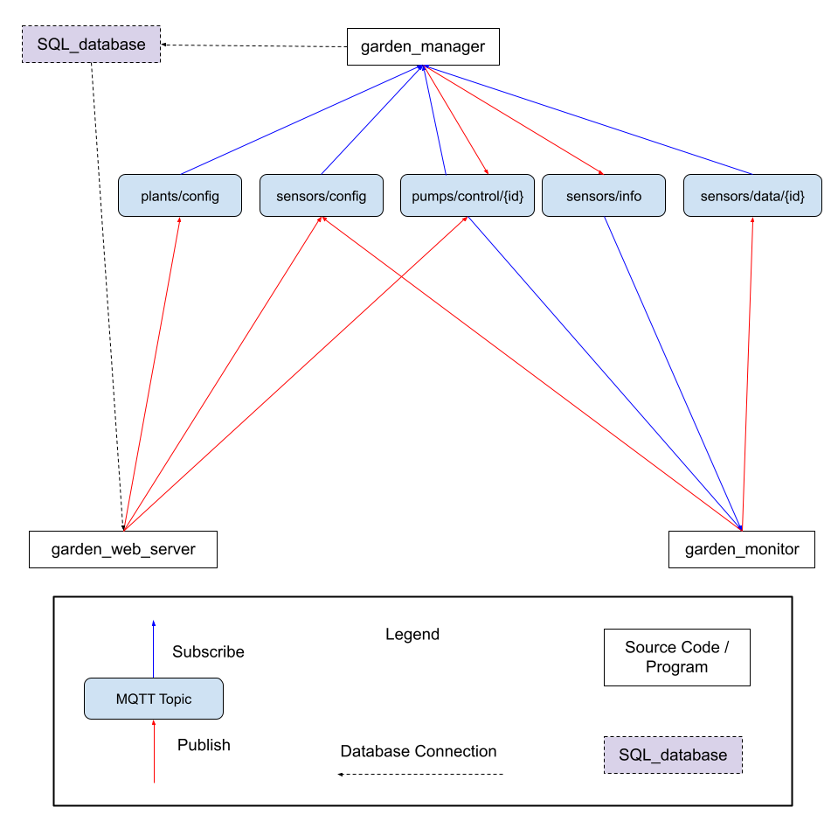
MQTT Topics
Configuration information, sensors data, and pump controls are sent over MQTT to communicate between the system components. Data not sent over MQTT is stored and accessed through an SQL database.

Slide 5
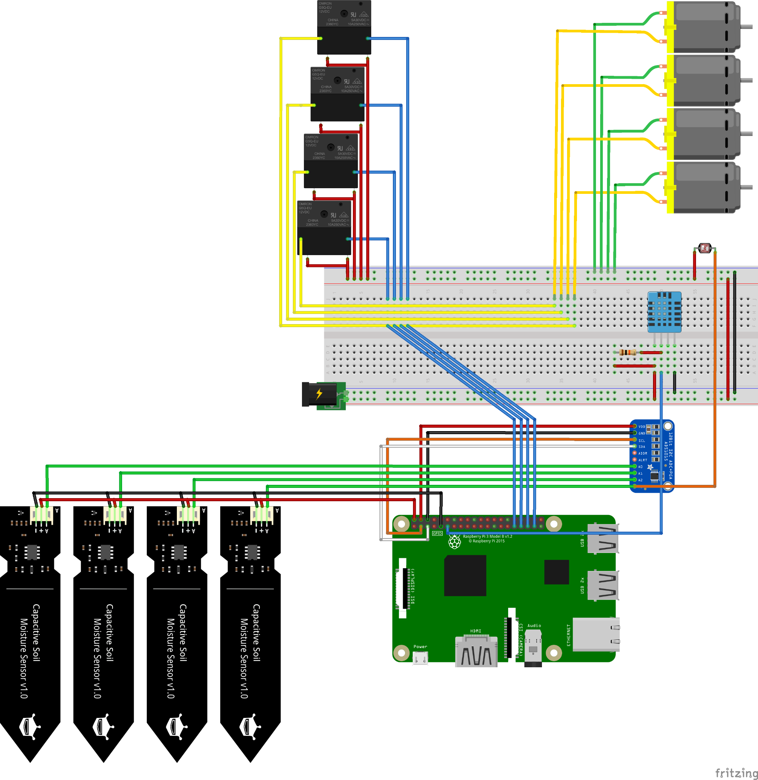
Hardware
Raspberry Pi 3b+
A breadboard
A prototyping board
4 capacitive soil humidity sensors
4 5V impeller water pumps
4 PCB-mounted 5V relays
A DHT22 (thermistor / hygrometer combo)
A photoresistor
An 8 channel ADC
22 Awg wires

Slide 6
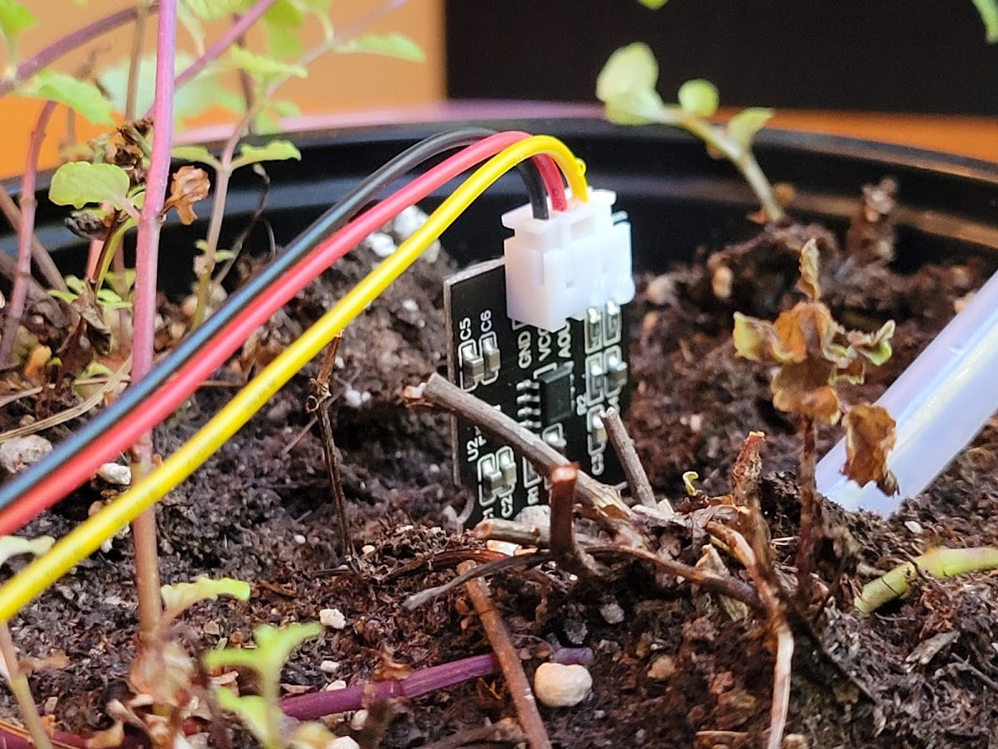
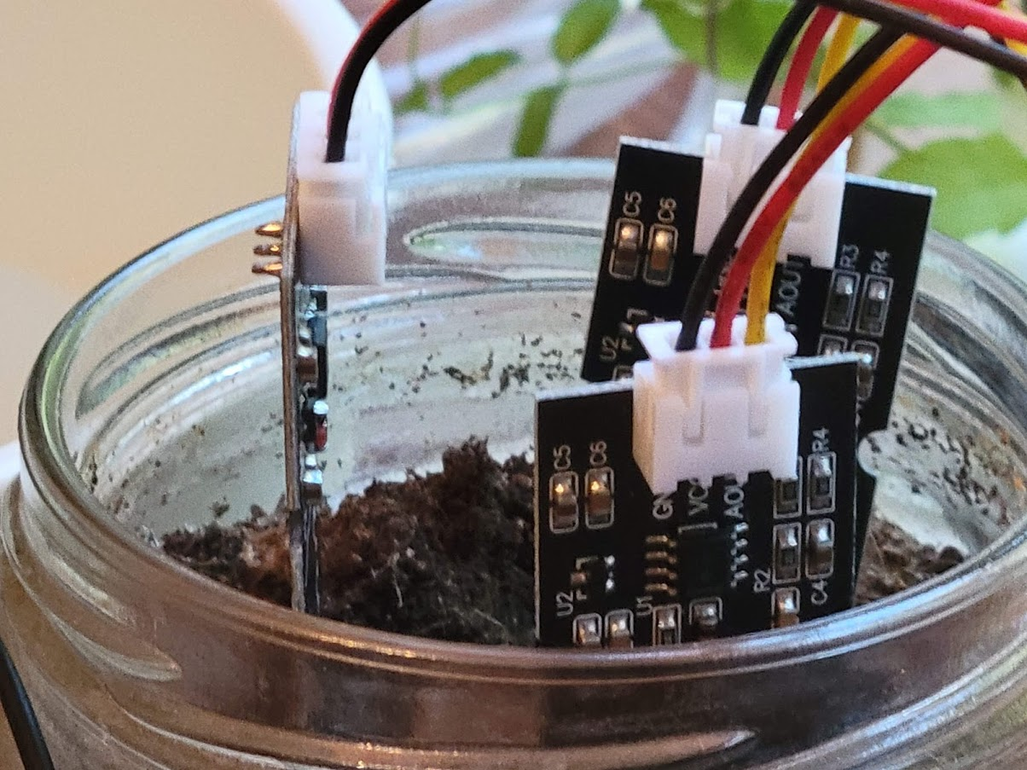

Slide 7
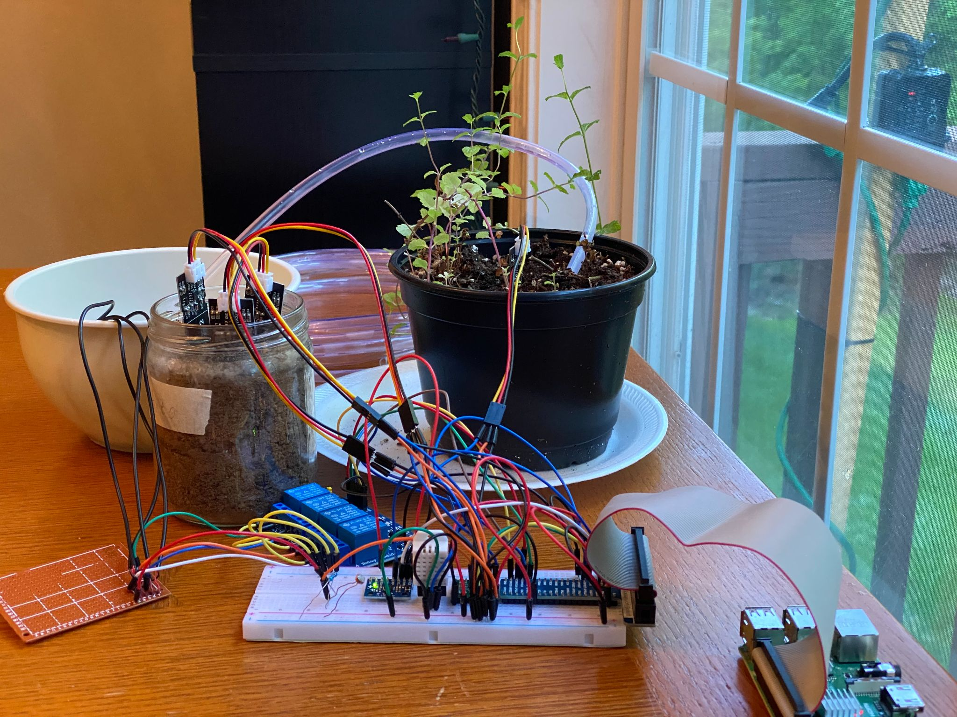

Slide 8
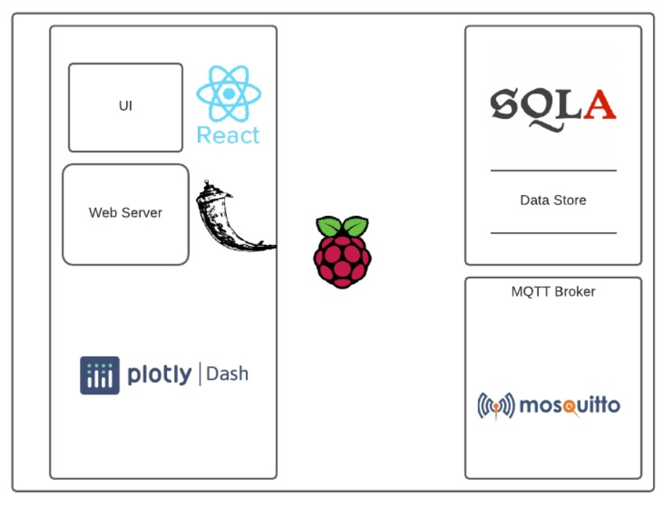
Implementation
Our project is built in Python using the libraries: Dash (web server), SQLAlchemy (database), Paho-MQTT, and GPIOZero
Three programs to run:
Garden Manager | Garden Monitor | Garden Web Server
Create database schema objects. Log sensor and event data to the database when received from the MQTT broker. Provide auto-watering functionality. Inform other components of configuration info read from the database. | Configure defaults for sensors. Collect and publish sensor data. Activate water pumps when instructed to do so. | Provide a web UI to interact with the Herb Garden Display current metrics for sensors Display a historic view of sensor values Allow configuration of plant and sensor objects Manually control pumps

Slide 9
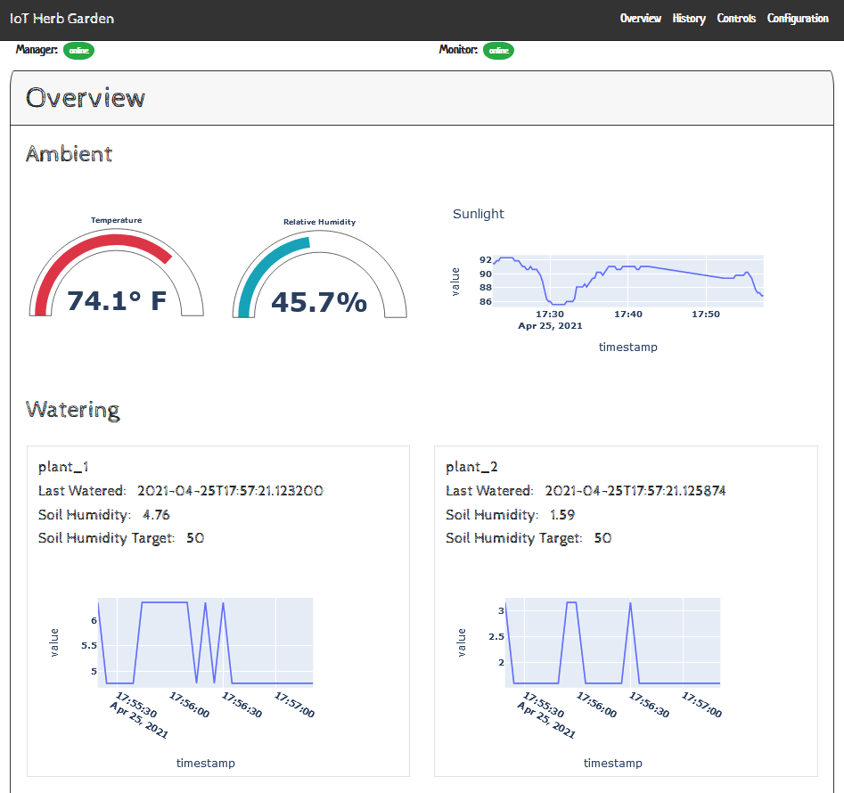

Slide 10
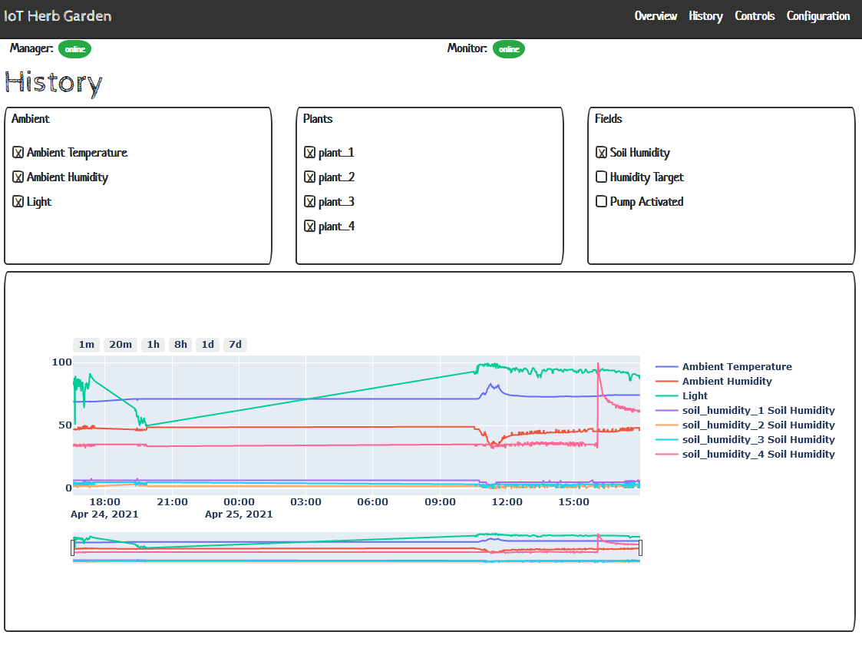

Slide 11
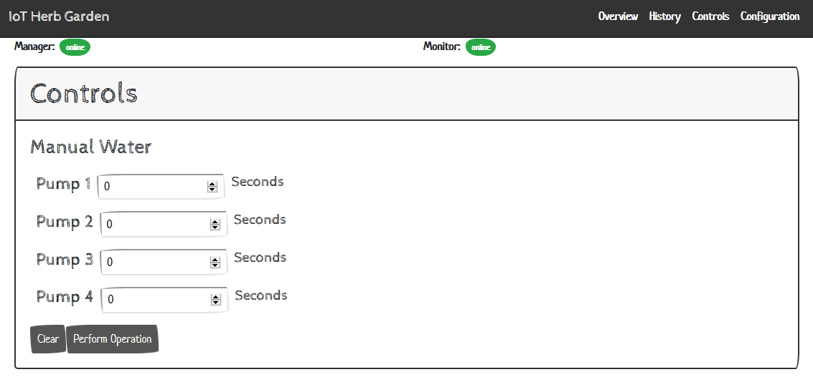

Slide 12
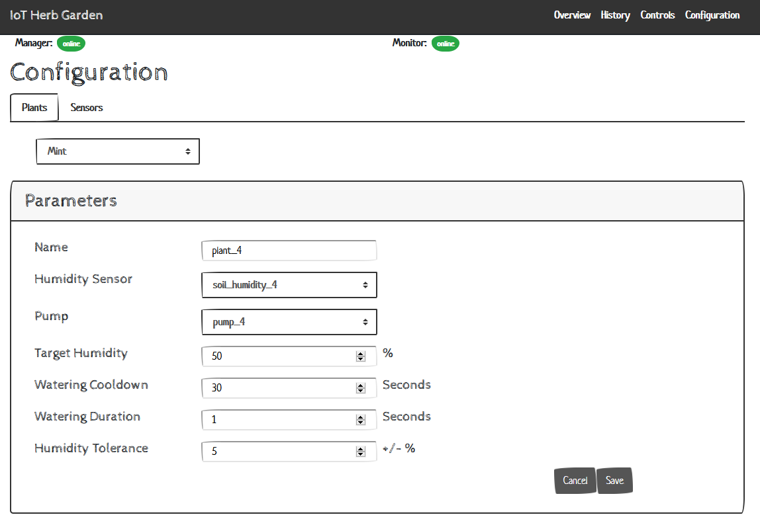

Slide 13
